Slide 1
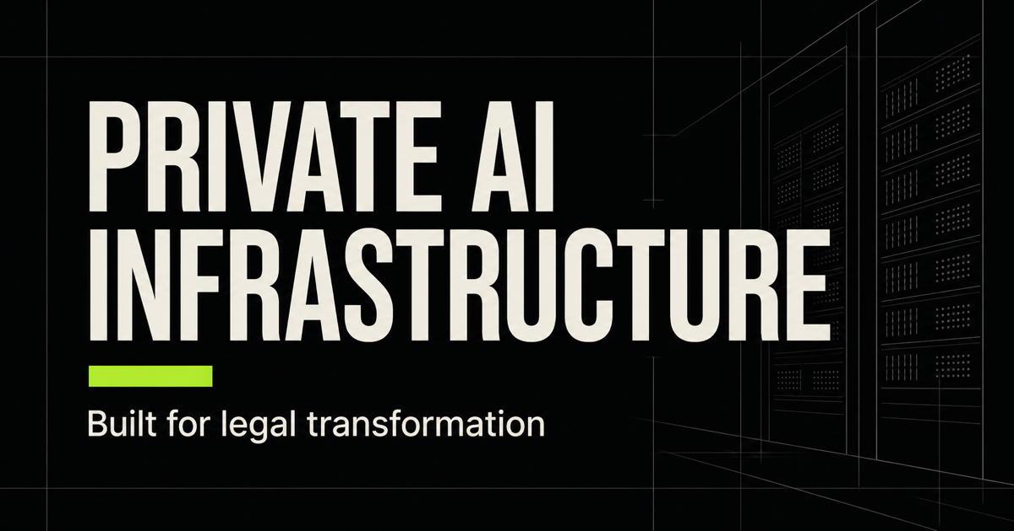
FLOWSTATELEGAL
THE FLOWSTATELEGAL OPTION
Notes:
[Sources]
- Original task-generated visual: social-preview-flowstate.png
- Positioning supplied by the user and informed by Flowstate_GTM_SC_Legal_Implementation_Proposal.docx

Slide 2
FLOWSTATELEGAL
THE PROBLEM
Legal AI is offering less control
at a higher cost.
The risk sits in both the commercial model and the security boundary.
01
Vendor lock-in
Proprietary platforms make migration expensive and tie firms to one vendor’s roadmap.
02
Metered pricing
For high-volume teams, a shift to usage pricing can create a 10× cost scenario.
03
Unclear data access
Firms may not know who can reach matter data, retrieval stores, logs, or backups.
PRIVATE AI INFRASTRUCTURE PARTNER
02 / 05
Notes:
[Sources]
- Cost scenario and market concerns supplied by the user.
- Source material: Flowstate_GTM_SC_Legal_Implementation_Proposal.docx

Slide 3
FLOWSTATELEGAL
THE SECURITY GAP
ZDR covers one link
in the security chain.
A no-retention promise at the model API does not secure the software around it.
01
Model API
ZDR can limit model-provider retention for eligible API content and endpoints.
02
Vendor layer
Vendor-operated prompts, logs, admin tools, backups, and support may sit outside that promise.
03
Knowledge base
Contracts should state where documents and indexes live, who can reach them, and when they are deleted.
PRIVATE AI INFRASTRUCTURE PARTNER
03 / 05
Notes:
[Sources]
- OpenAI API data controls: https://platform.openai.com/docs/models/default-usage-policies-by-endpoint
- NIST SP 800-207, Zero Trust Architecture: https://www.nist.gov/publications/zero-trust-architecture

Slide 4
FLOWSTATELEGAL
HOW IT WORKS
Install on-site once. Let us keep it running.
We write the software, secure the server in place, and maintain it remotely.
01
02
03
CUSTOM SOFTWARE
ON-PREM SETUP
REMOTE CARE
Fit the firm’s work
Secure it once
Keep it running
Models, workflows, permissions, integrations, and a clear user experience.
Server, network, encryption, access rules, audit logs, backups, and acceptance tests.
Monitoring, updates, performance, support, and planned expansion handled off-site.
No specialist AI infrastructure hires required.
Firm IT keeps oversight. FlowStateLegal runs the stack.
PRIVATE AI INFRASTRUCTURE PARTNER
04 / 05
Notes:
[Sources]
- Delivery model and maintenance scope supplied by the user.
- Source material: Flowstate_GTM_SC_Legal_Implementation_Proposal.docx

Slide 5
FLOWSTATELEGAL
LONG-TERM VALUE
Ownership improves the economics over time.
The firm buys an asset, controls its data, and avoids a rising per-use software bill.
01
02
03
GPU ACCESS
PREDICTABLE COST
LEAN OPERATIONS
Buy below market rate
Pay for capacity
Avoid a new specialist team
We source through chip manufacturer and distributor relationships.
No per-token vendor margin. The same server supports more matters as adoption grows.
FlowStateLegal maintains the stack remotely under a defined support scope.
Start with one private environment.
Scope → source → install
PRIVATE AI INFRASTRUCTURE PARTNER
05 / 05
Notes:
[Sources]
- GPU pricing access and manufacturer relationships supplied by the user.
- Cost framing is a qualitative ownership comparison, not a quoted savings guarantee.

